Slide 1


Synergy Link: Connecting Personalities for Meaningful Conversations
Synergy Link is a chat platform that goes beyond random connections. Our platform uses the MBTI personality assessment and goal setting tools to connect you with individuals who share your personality type and aspirations, fostering friendships, collaborations, and a supportive network.
by Gourav Singh Chauhan
12112430

Slide 2
Technologies Used :
Front End:
React
Vite
HTML
tailwind css
CSS
Back End:
Express
Mongoose
socket.io
node.js
bcrypt js
.env

Slide 3




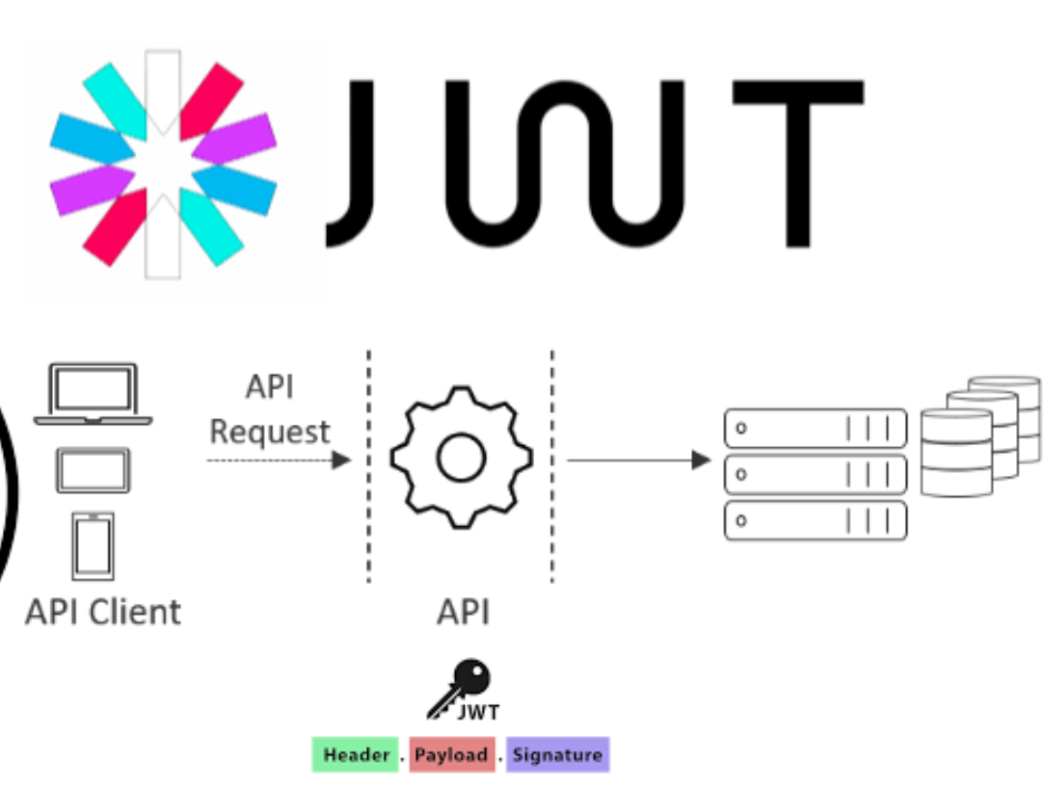
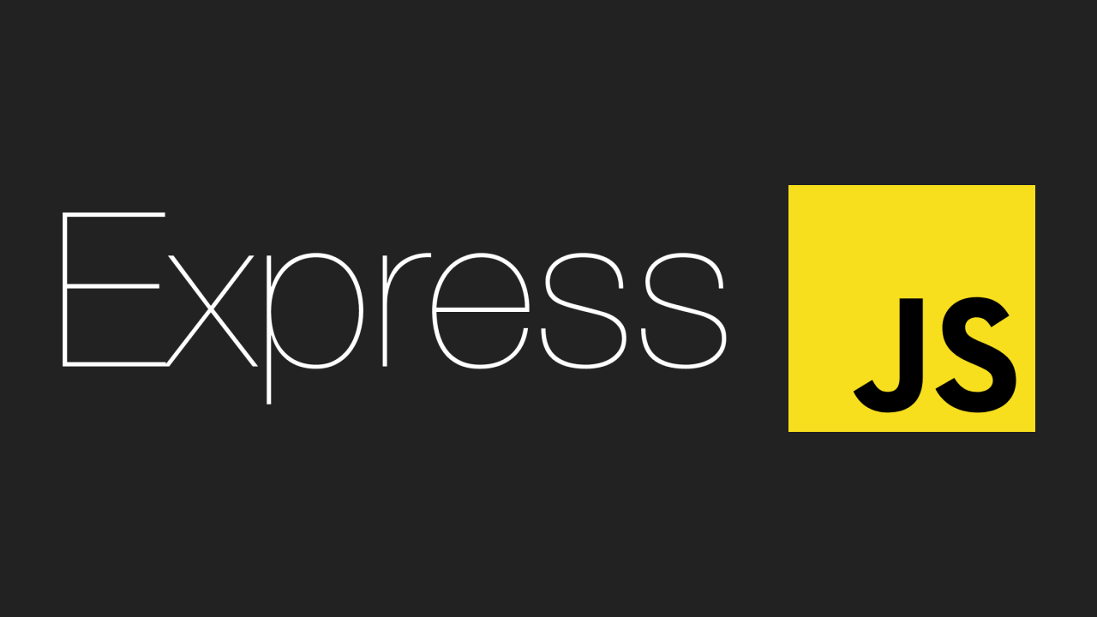



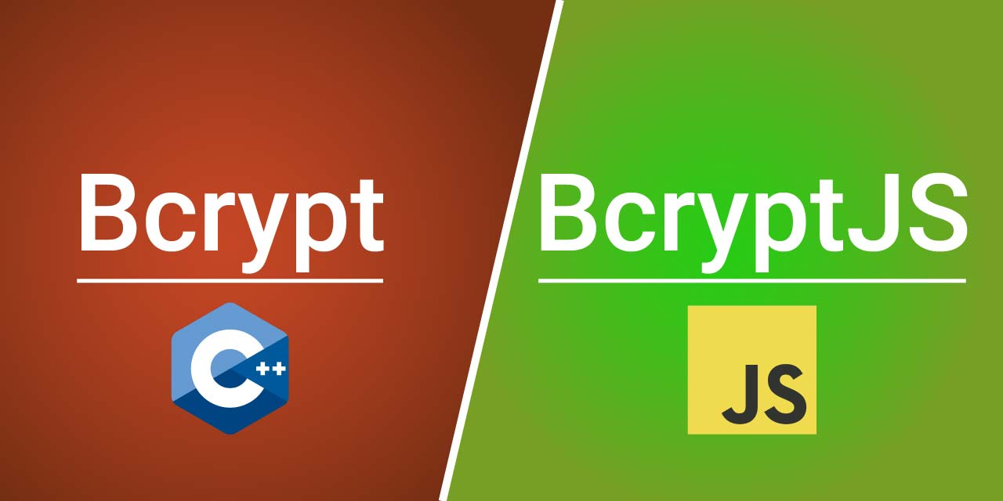
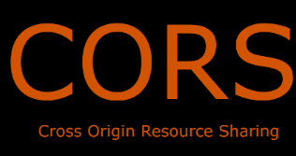

Slide 4
Addressing the Problem of Superficial Connections
Lack of Meaningful Interactions
Random connections often lead to shallow conversations and fleeting interactions.
Difficulty Finding Like-Minded People
Traditional platforms don't cater to users seeking connections based on personality compatibility and shared goals.
Ineffective Icebreakers
Generic greetings and awkward introductions hinder meaningful conversation starters.
Prioritization of Quantity over Quality
Many platforms focus on accumulating a large number of connections, neglecting the quality and depth of interactions.

Slide 5
Personality-Based Matching
Personality Compatibility
Shared Interests
Meaningful Interactions
By understanding your personality, we can match you with individuals who share your hobbies, values, and communication preferences, making it easier to find people you truly connect with.
Our algorithm analyzes user profiles and personality traits to create connections with people who share compatible personalities with similar communication styles and interests. For example, an INTJ personality type may have a good match with ENFP, ENTJ, and ENTP.
Synergy Link's personality-based matching helps break the ice and spark engaging conversations, reducing the awkwardness often associated with online interactions.

Slide 6
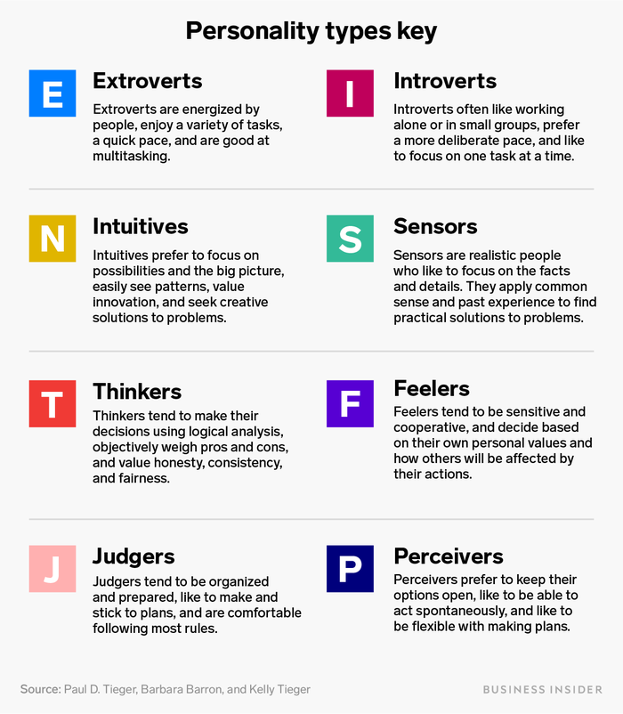

Slide 7
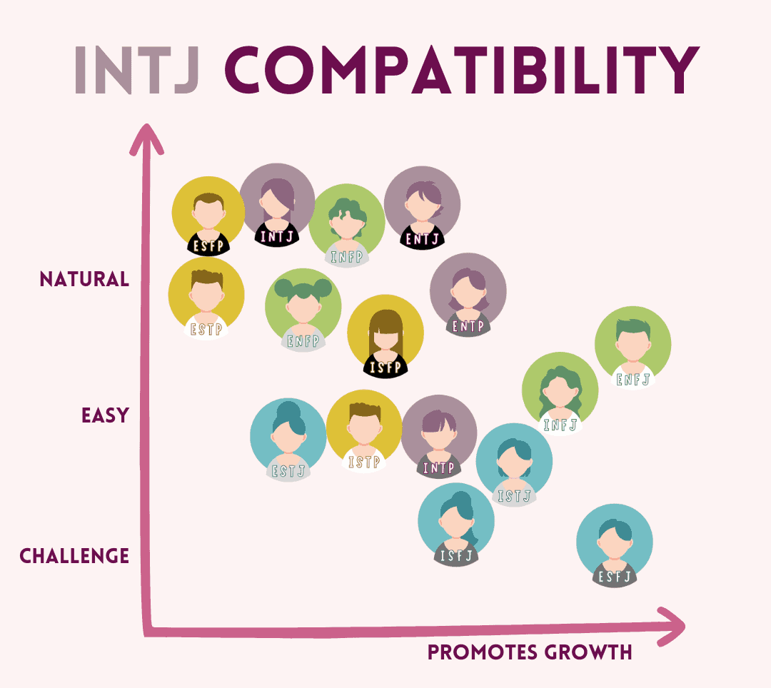
INTJs are most compatible with ENFP, ENTJ, and ENTP personality types.

Slide 8
match = {
intj : { enfp, entj, entp,
},
enfp : { intj, infj
},
…
}

Slide 9
Quality Over Quantity
1
2
Prioritize Genuine Connections
Reduce Awkwardness
Synergy Link focuses on creating a space for users to build meaningful connections based on shared ground, rather than accumulating a large network of superficial interactions.
Our platform's icebreakers and personality matching features help users connect more easily and engage in conversations that go beyond small talk.
3
Discover New Perspectives
4
Build Your Tribe
By connecting with individuals from diverse backgrounds and viewpoints, Synergy Link users can foster personal growth and gain new insights.
Synergy Link allows users to connect with like-minded individuals for conversation, collaboration, or to simply build a supportive network.

Slide 10

Who is Synergy Link For?
Individuals Seeking Connections
Those Seeking Meaningful Interactions
Synergy Link is for those who are looking to expand their social circle and connect with people who truly understand them based on personality and shared goals.
Synergy Link is for people who value stimulating conversations and meaningful online interactions, going beyond the superficial connections often found on other platforms.
Those Who Value Personality Compatibility
Synergy Link is for individuals who prioritize personality compatibility in their friendships and connections, seeking to build genuine relationships with like-minded individuals.

Slide 11




Synergy Link: Beyond a Chat Platform
Personality Matching
Synergy Link's algorithm analyzes user profiles and personality traits to create connections with compatible individuals.
Goal-Oriented Matching
Users can define their personal and professional goals, and the platform will connect them with like-minded individuals.
Genuine Connections
The "Synergy Spark" feature helps users demonstrate their genuine interest and compatibility, fostering meaningful interactions.

Slide 12

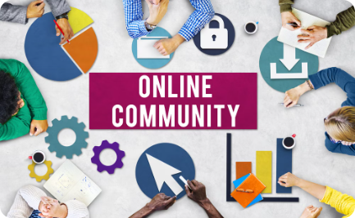
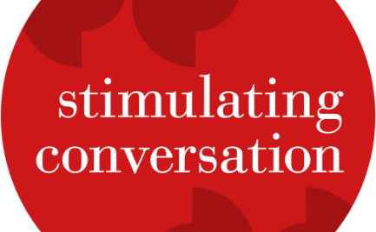
Join the Synergy Link Community
Unlock Meaningful Connections
Cultivate a Supportive Network
Engage in Stimulating Conversations
Synergy Link is more than just a chat platform - it's a space where you can build genuine connections based on shared personality traits, aspirations, and goals.
Join Synergy Link and experience the power of a community where you can find like-minded individuals, collaborate on projects, and support each other's growth.
Synergy Link's personality-based matching and icebreakers help you connect with people who truly understand you, leading to engaging discussions and personal growth.

Slide 13
The Future of Meaningful Online Connections
1
2
Expanding Matching Capabilities
Deepening User Engagement
Synergy Link plans to integrate additional personality assessments and leverage AI-powered algorithms to create even more refined and accurate connections.
The platform aims to introduce interactive activities, virtual events, and monetization options to foster a more vibrant and engaged online community.
3
4
Embracing Emerging Technologies
Addressing Potential Challenges
Synergy Link is exploring the potential of integrating virtual reality, augmented reality, and brain-computer interfaces to enhance user interaction and create deeper emotional connections.
The platform is committed to continuously refining its algorithms, implementing robust user verification measures, and prioritizing user privacy to ensure a safe and inclusive online experience.

Slide 14
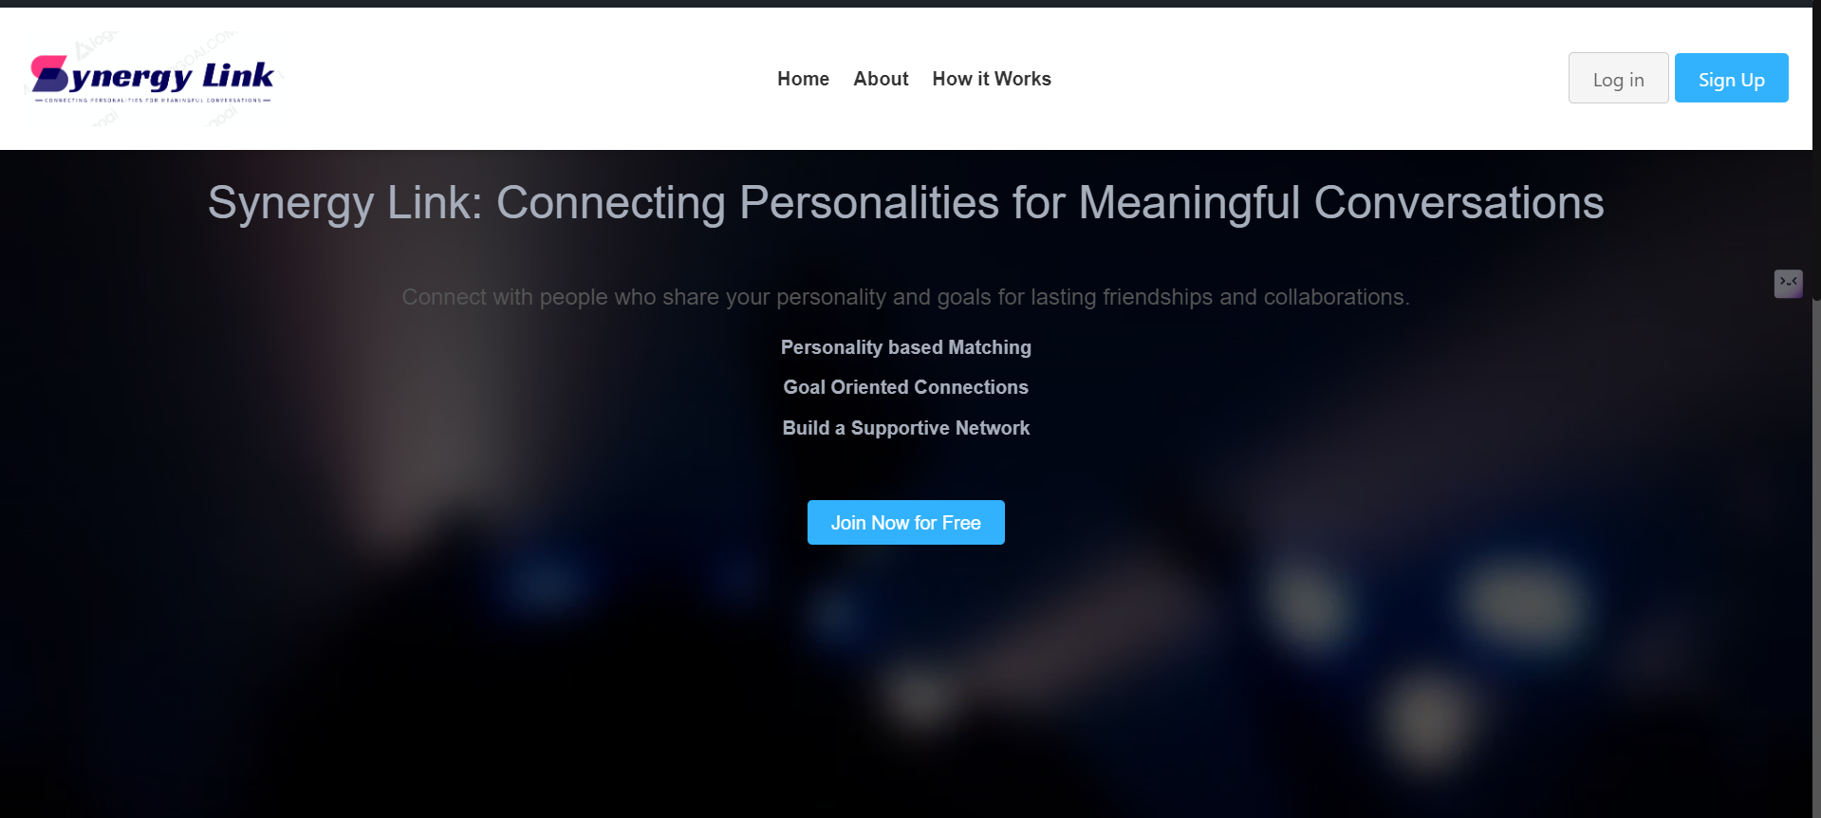

Slide 15
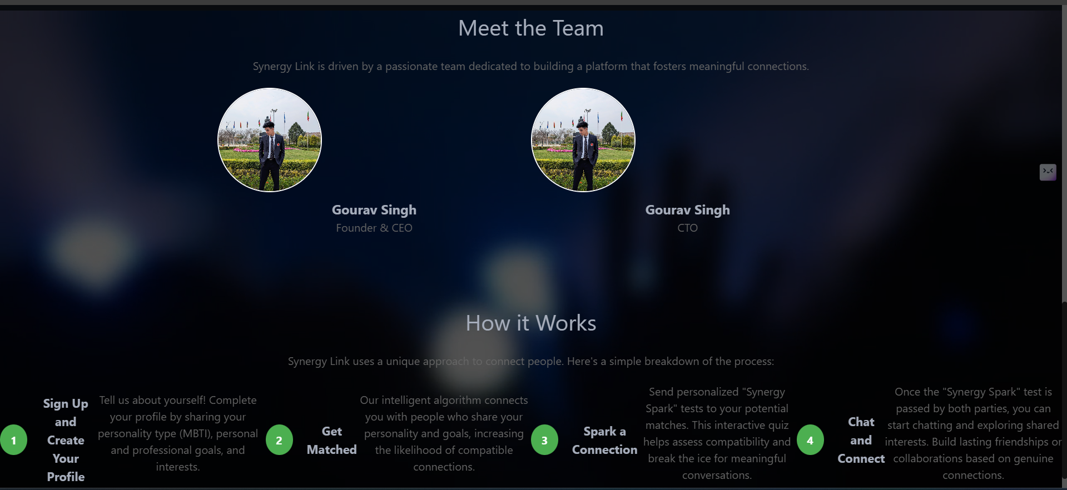

Slide 16
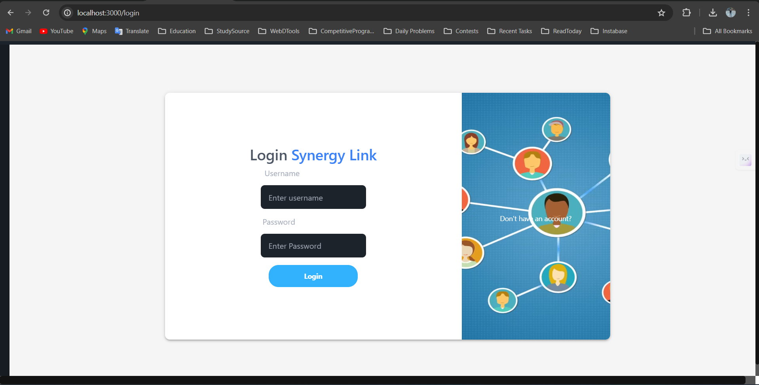

Slide 17
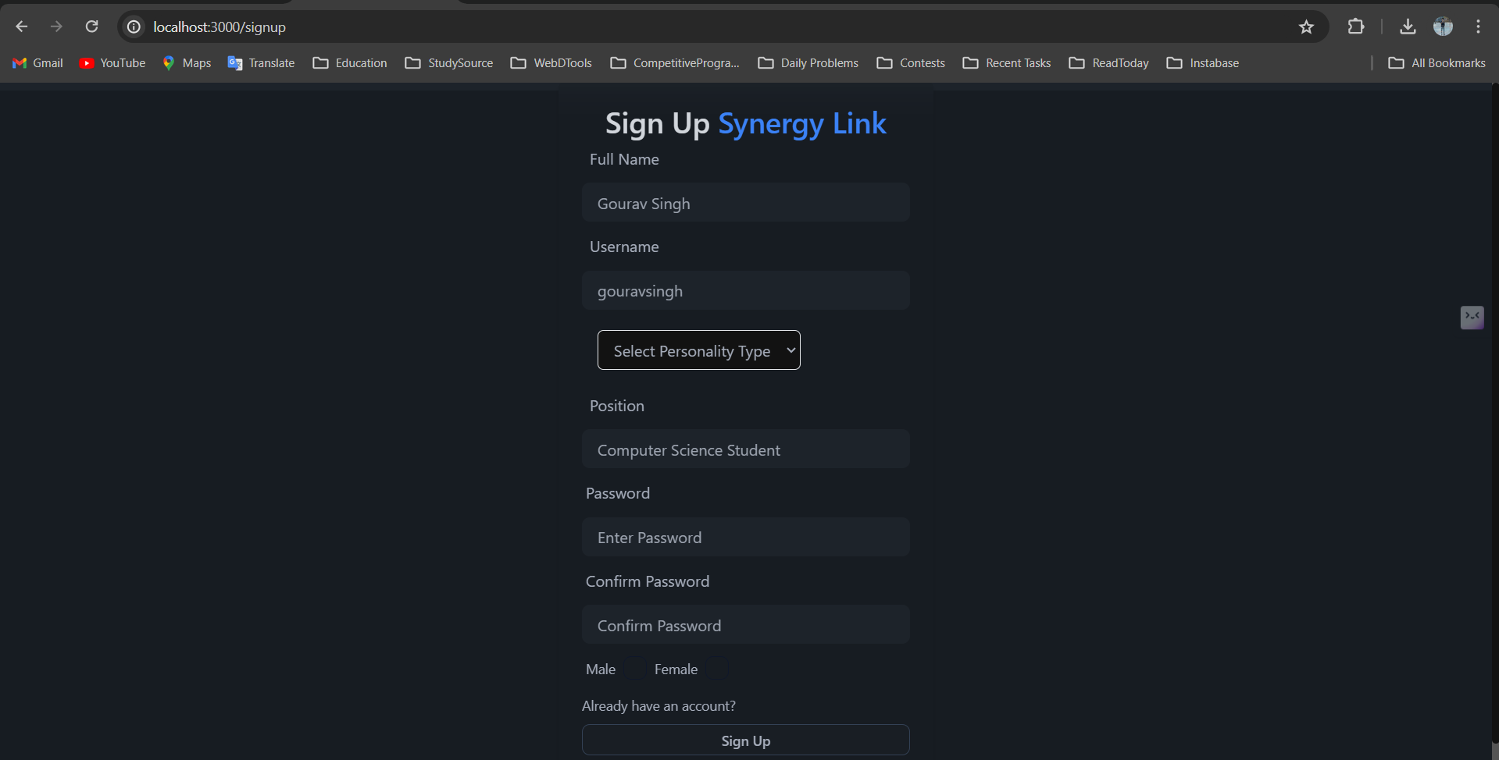

Slide 18
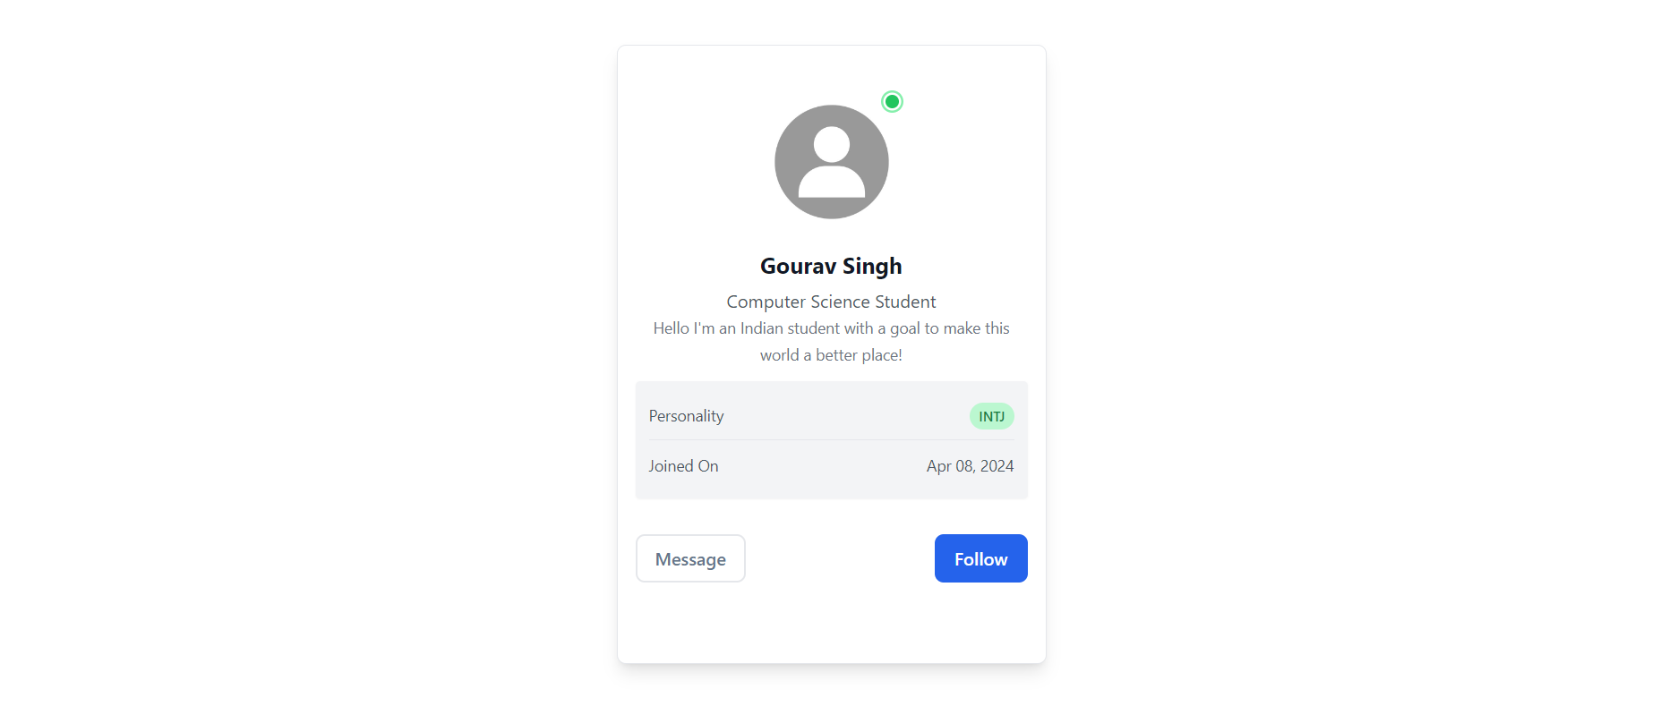

Slide 19
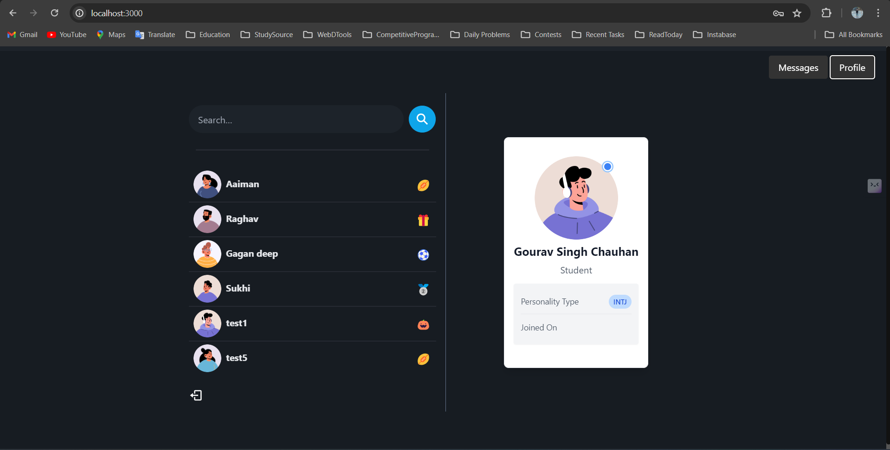

Slide 20
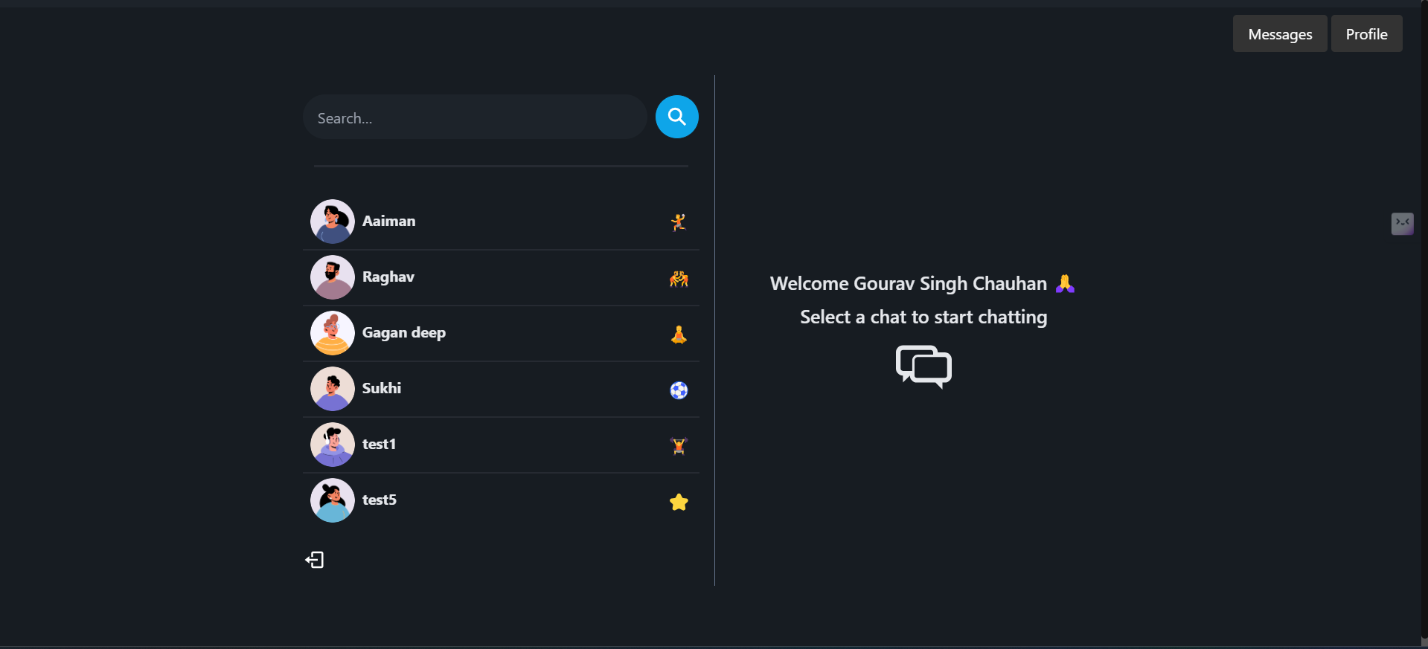

Slide 21
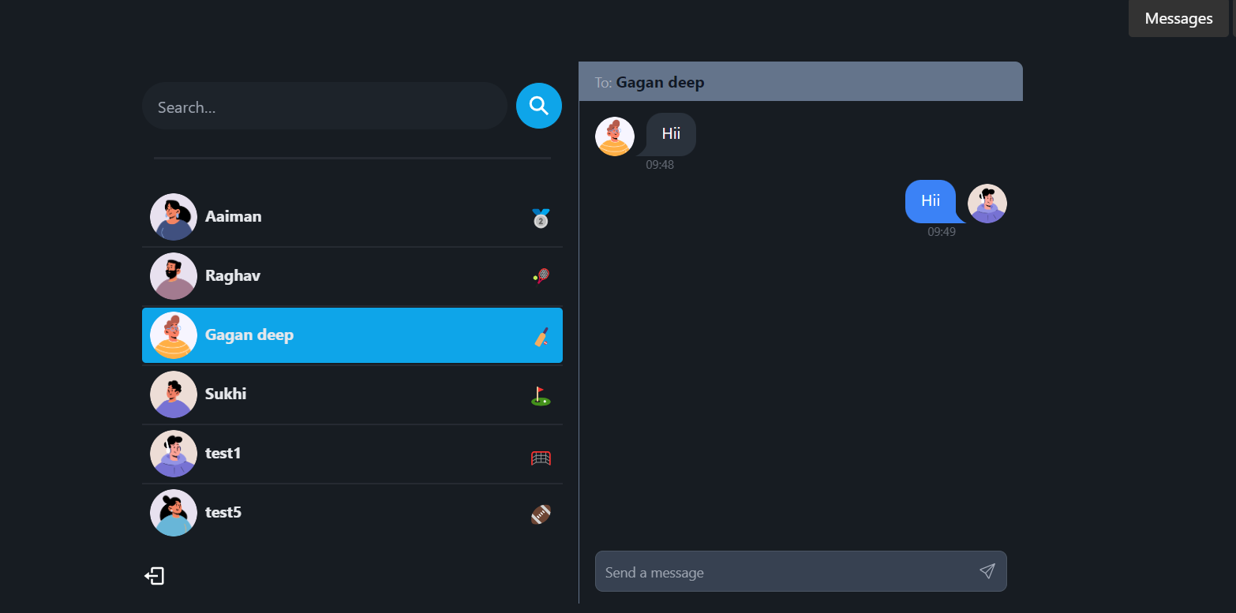

Slide 22
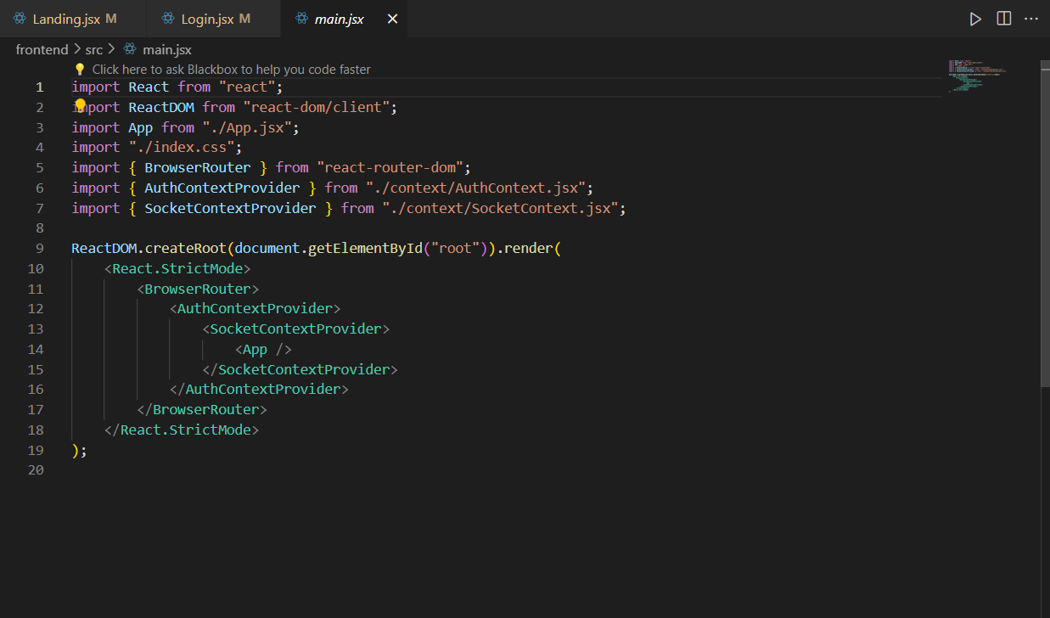

Slide 23
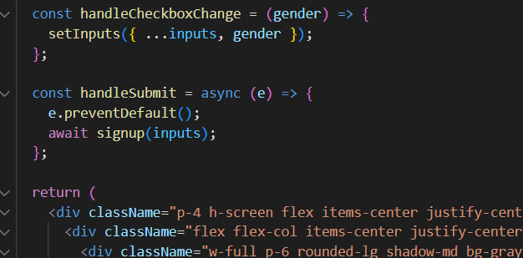
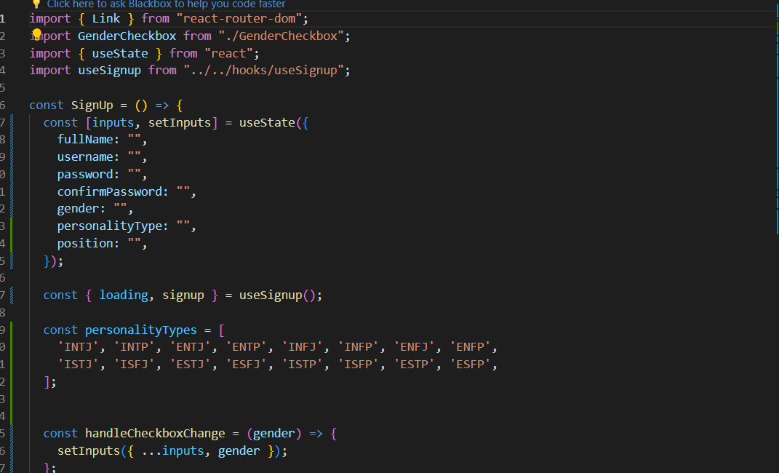
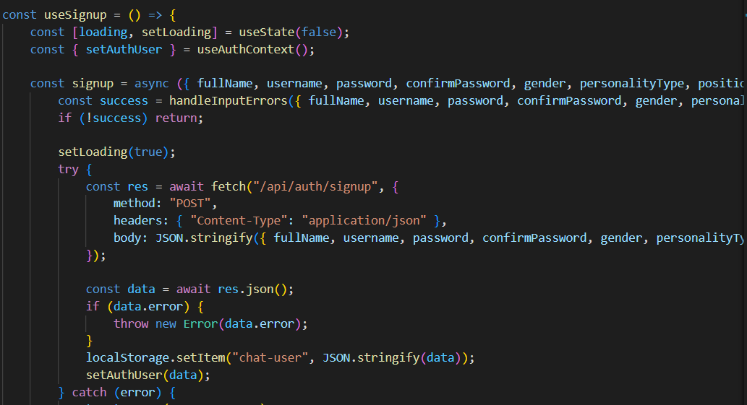

Slide 24
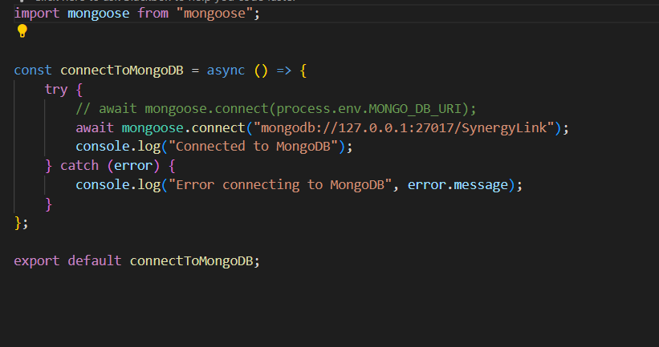

Slide 25
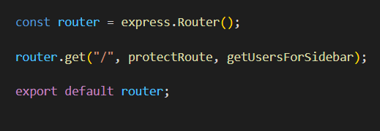
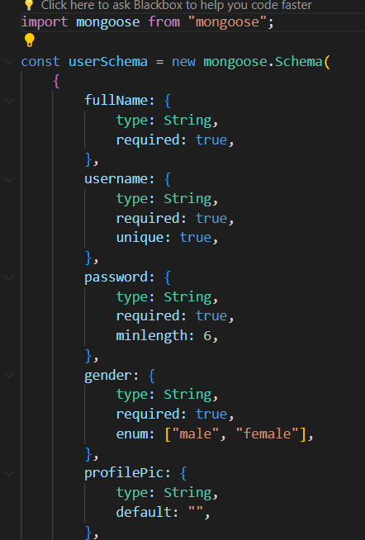
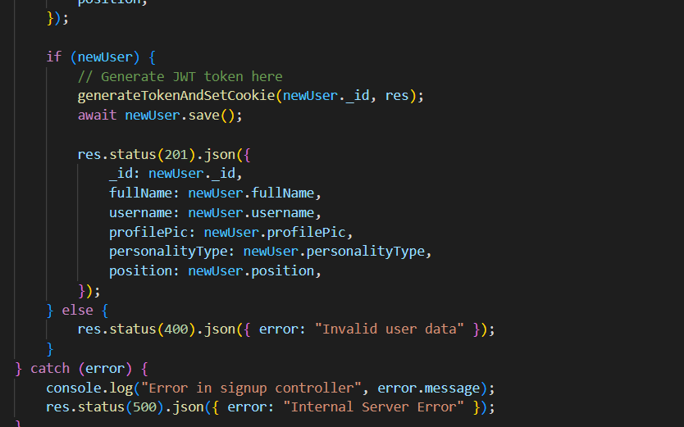

Slide 26
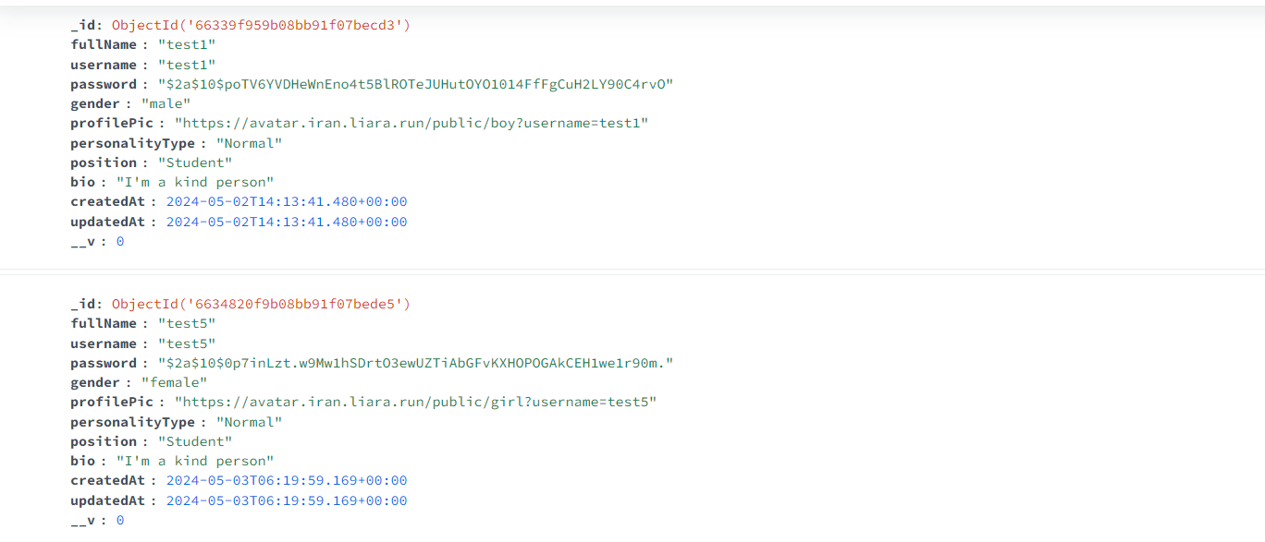

Slide 27
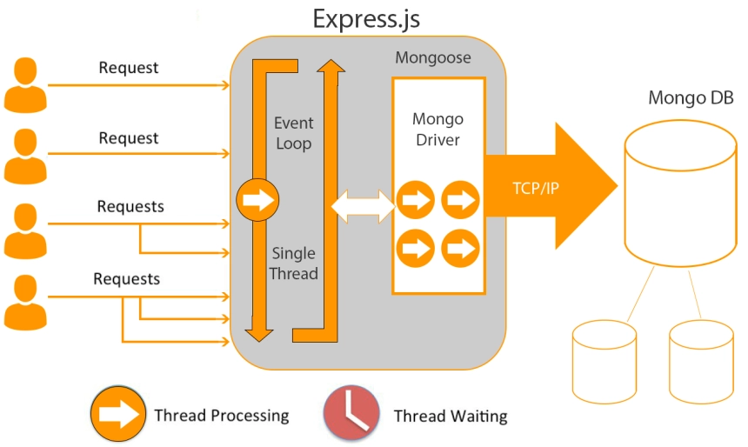
express.js
It provides a robust set of features and functionalities to simplify the process of building web applications and APIs using JavaScript on the server-side.

Slide 28
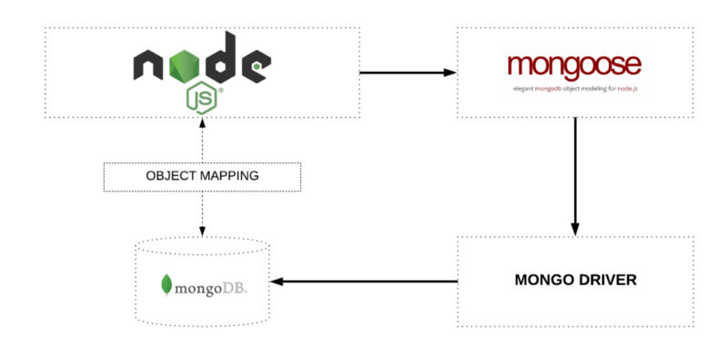
mongoose

Slide 29
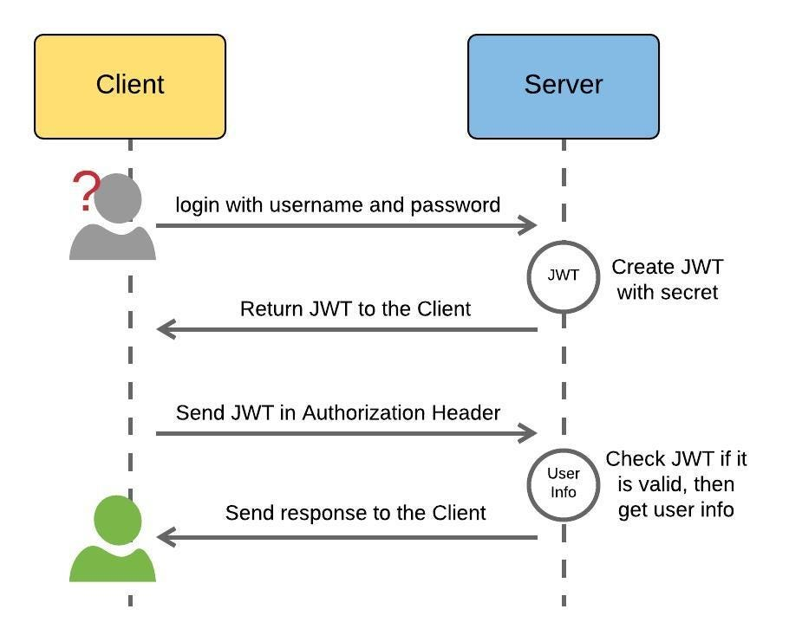
json web token (jwt)
JWTs are a compact and secure way to represent claims (pieces of information) between two parties.

Slide 30
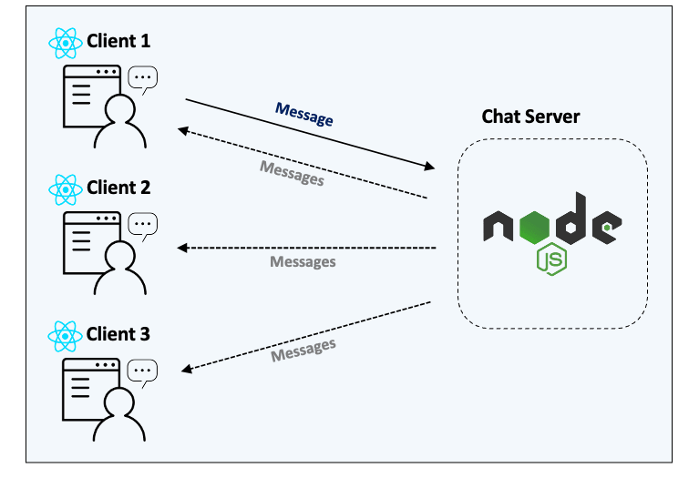
socket.io
Socket.IO is a JavaScript library that enables real-time, bidirectional communication between web clients (browsers) and servers.

Slide 31
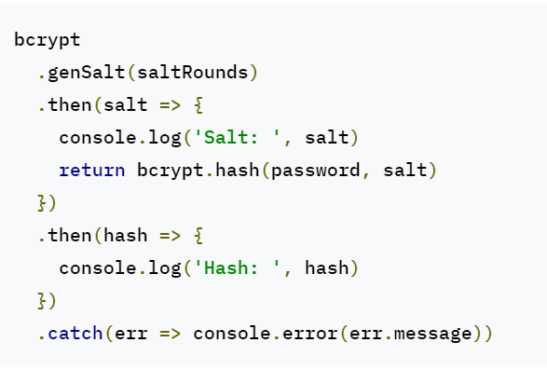
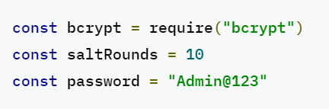
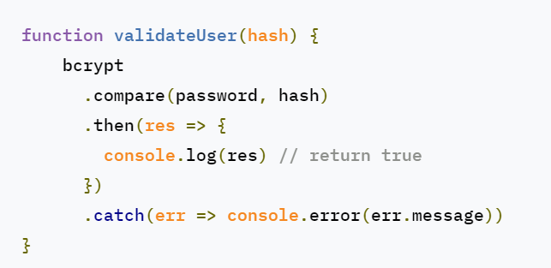
bcryptjs

Slide 32
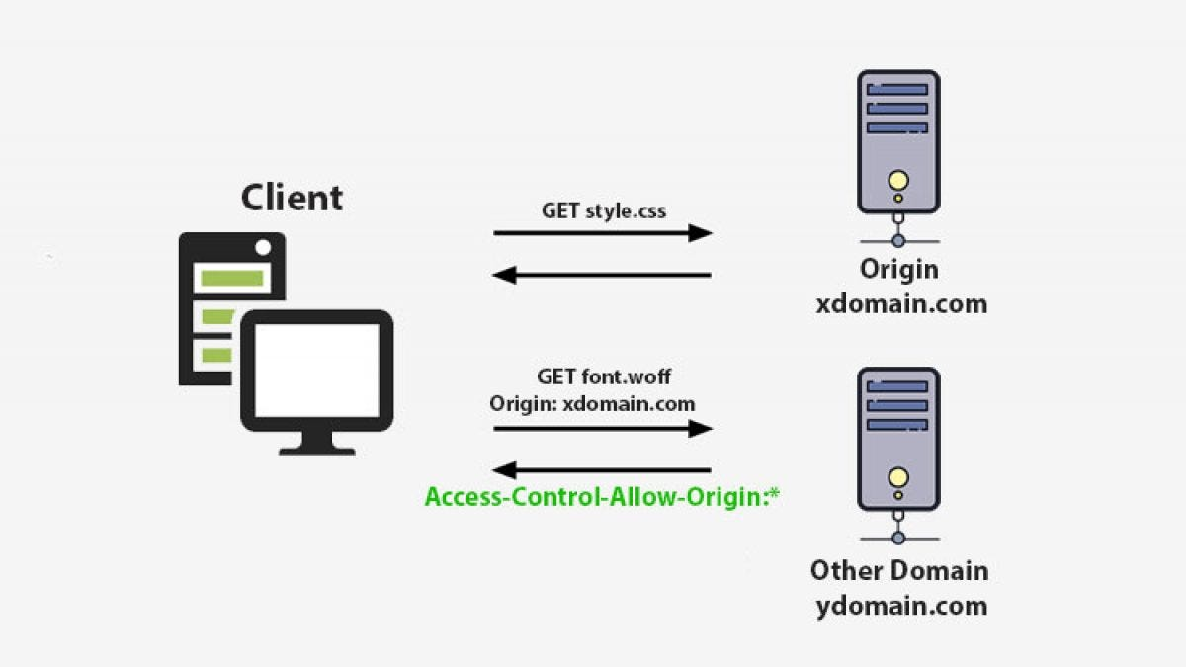
cors
CORS (Cross-Origin Resource Sharing) is a security mechanism implemented by web browsers that restricts how a web page from one domain can request resources from a different domain.

Slide 33
https://github.com/infinity-boi/synergy-link
Thank You

